Slide 1
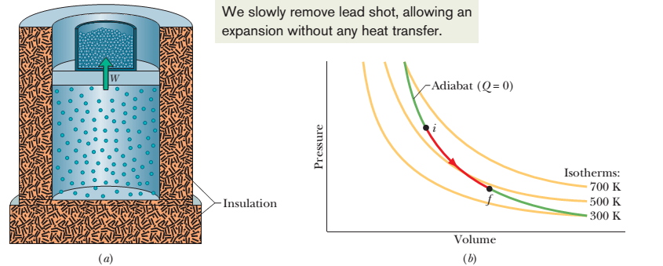
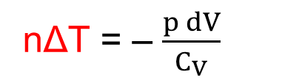
Lecture 8
Chapter 19: The Kinetic Theory of Gases
19-9 Adiabatic expansion of an ideal gas: p$V^{γ}$= a constant , where 𝛾 = $\frac{\text{C}\text{p} }{C_{V}}$
adiabatic process, Q = 0
Suppose that you remove some shots from the piston, allowing the ideal gas to push the piston and the remaining shots upward and thus to increase the volume by a differential amount dV. Since the volume change is tiny, we may assume that the pressure p of the gas on the piston is constant during the change. The work dW done by the gas during the volume increase is equal to W = p dV.
1st law of thermodynamics, ΔE_{int} = Q – W
nC_{V} ΔT = 0 – p dV
nΔT = – $\frac{p dV}{C_{V}}$
[ΔE_{int} = Q – W = nC_{V} ΔT – pΔV = nC_{V} ΔT– p(V – V) = nC_{V} ΔT– p(0) = nC_{V} ΔT]

Slide 2
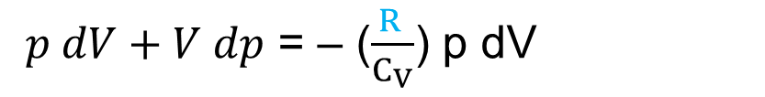
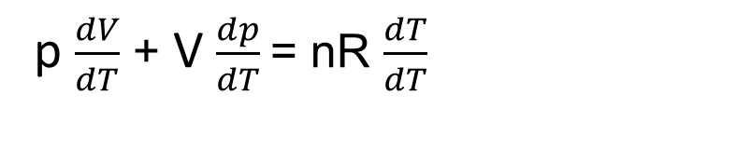
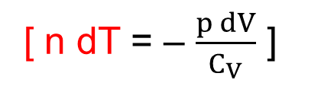
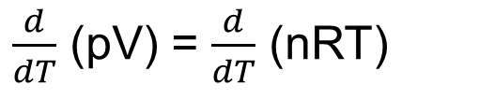
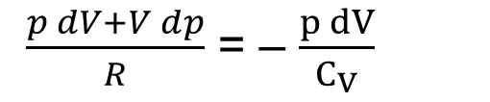
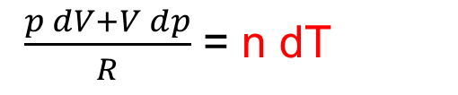
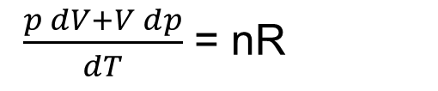
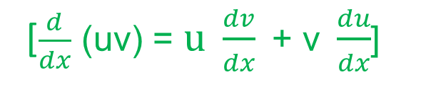
Ideal gas equation, pV = nRT
$\frac{d}{dT}$ (pV) = $\frac{d}{dT}$ (nRT)
[$\frac{d}{dx}$ (uv) = $\text{u} \frac{dv}{dx}\text{ + }\text{v} \frac{du}{dx}$]
p $\frac{dV}{dT}$ + V $\frac{dp}{dT}$= nR $\frac{dT}{dT}$
$\frac{p dV+V dp}{dT}$ = nR
$\frac{p dV+V dp}{R}$ = n dT
$\frac{p dV+V dp}{R}$ = – $\frac{p dV}{C_{V}}$
[ n dT = – $\frac{p dV}{C_{V}}$ ]
$p dV+V dp$ = – ($\frac{R }{C_{V}}$) p dV
[C_{p} – C_{V} = R]

Slide 3

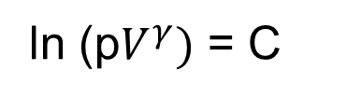
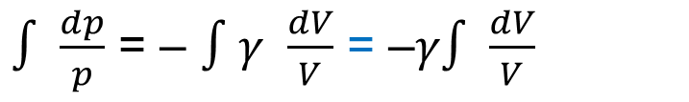

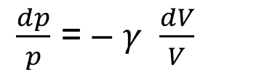
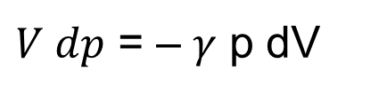
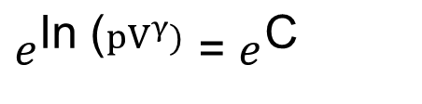
$p dV+V dp$ = – ($\frac{\text{C}\text{p}\text{ – }\text{C}\text{V}}{C_{V}}$) p dV = – ($\frac{\text{C}\text{p} }{C_{V}}$ $\text{–}$ 1) p dV = – ($γ$ $\text{–}$ 1) p dV = – 𝛾 p dV + p dV
$V dp$ = – 𝛾 p dV
$\frac{dp}{p}$ = – 𝛾 $\frac{dV}{V}$
[$divided by pV]$
$∫$ $\frac{dp}{p}$ = – $∫$𝛾 $\frac{dV}{V}$ = –𝛾$∫$ $\frac{dV}{V}$
ln p + C₁= - 𝛾 ln V + C₂
ln p + 𝛾 ln V = C
ln p + ln $V^{γ}$ = C
ln (p$V^{γ})$ = C
$e^{\text{ln}\text{ (}pV^{γ})}$ = $e^{\text{C}}$
p$V^{γ}$ = a constant [adiabatic expansion or compression]
p_{i}${Vi}^{γ}$ = p_{f}${Vf}^{γ}$ [from an initial state, i to a final state, f]

Slide 4
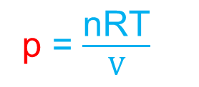

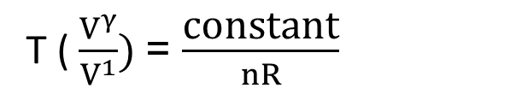
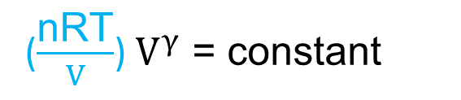
19-9 T$V^{γ−1}$ = constant for an adiabatic process:
For an adiabatic process, p$V^{γ}$ = constant
To write an equation for an adiabatic process in terms of T and V, we use the ideal gas equation to eliminate p
Ideal gas equation, pV = nRT
p = $\frac{\text{nRT}}{V}$
($\frac{\text{nRT}}{V}$) $V^{γ}$ = constant
T ( $\frac{V^{γ}}{V^{1}})$= $\frac{\text{constant}}{nR}$
[n and R are constants]
T$V^{γ−1}$ = constant
When the gas goes from an initial state i to a final state f: T_{i}${Vi}^{γ−1}$ = T_{f}${Vf}^{γ−1}$

Slide 5
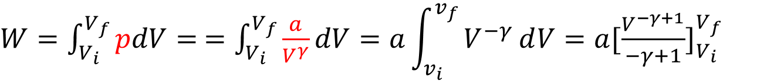
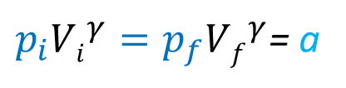
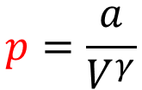
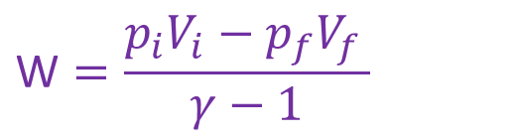
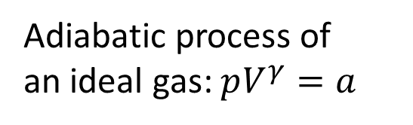
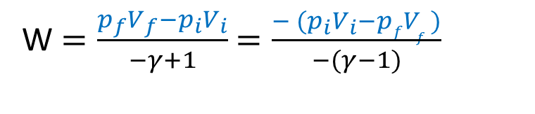
19-9 W$ork done for an ideal gas in an adiabatic process: W=\frac{P_{i}V_{i}−P_{f}V_{f}}{γ−1}$
$W=\int_{V_{i}}^{V_{f}}{pdV}=$ $=\int_{V_{i}}^{V_{f}}{\frac{a}{V^{γ}}dV}=a\int_{v_{i}}^{v_{f}}{V^{−γ}ⅆV=a{[\frac{V^{−γ+1}}{−γ+1}]}_{V_{i}}^{V_{f}}}$
Adiabatic process of
an ideal gas: $pV^{γ}=a$
$W=\frac{a}{−γ+1}$ ${[V^{−γ+1}]}_{V_{i}}^{V_{f}}$ $=\frac{a}{−γ+1}$($V_{f}^{−γ+1}$- $V_{i}^{−γ+1}$)
$$p=\frac{a}{V^{γ}}$$
$p_{i}{Vi}^{γ}=p_{f}{Vf}^{γ}$= a
$W=\frac{{aV}_{f}^{−γ+1}\text{− }{aV}_{i}^{−γ+1}}{−γ+1}$ $=\frac{{p_{f}{Vf}^{γ}V}_{f}^{−γ+1}\text{− }{p_{i}{Vi}^{γ}V}_{i}^{−γ+1}}{−γ+1}$ $=\frac{{p_{f}V}_{f}^{γ−γ+1}\text{− }{p_{i}V}_{i}^{γ−γ+1}}{−γ+1}$
W $=\frac{p_{f}V_{f}−p_{i}V_{i}}{−γ+1}$ $=\frac{{− (p}_{i}V_{i}−pfV_{f })}{−(γ−1)}$
$$\text{W}=\frac{p_{i}V_{i}−p_{f}V_{f }}{γ−1}$$

Slide 6
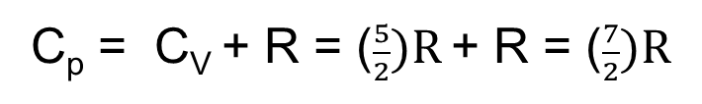

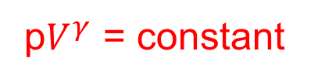
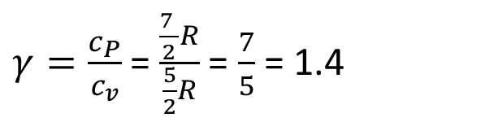
54. We know that for an adiabatic process pV^{γ} = a constant. Evaluate “a constant” for an adiabatic process involving exactly 2.0 mol of an ideal gas passing through the state having exactly p = 1.0 atm and T = 300 K. Assume a diatomic gas whose molecules rotate but do not oscillate.
Solution:
Here, n = 2 mol
p = 1.0 atm = 1.0x10⁵ Pa
T = 300 K
p$V^{γ}$ = constant
Diatomic gas whose molecules rotate but do not oscillate, f = 3+2 = 5
C_{V} = ($\frac{f}{2})R=$ ($\frac{5}{2})R$
C_{p} – C_{V} = R
C_{p} = C_{V} + R = ($\frac{5}{2})R$ + R = ($\frac{7}{2})R$
$γ=\frac{c_{P}}{c_{v}}$ =$\frac{\frac{7 }{2}R}{\frac{5}{2}R}$ = $\frac{7}{5}$ = 1.4

Slide 7
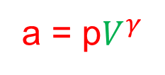
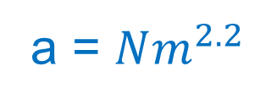

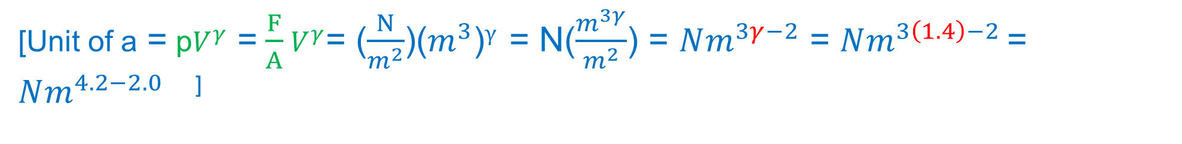
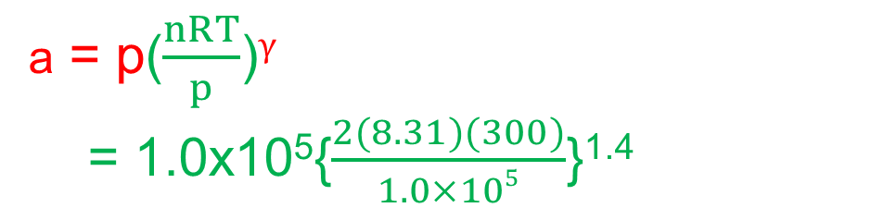
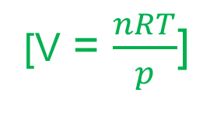
p$V^{γ}$ = constant
a = p$V^{γ}$
[Ideal gas law, pV = nRT]
a = p($\frac{nRT}{p}$)$γ$
= 1.0x10⁵{$\frac{2(8.31)(300)}{1.0×105}$}^{1.4}
[V = $\frac{nRT}{p}$]
= 1.0x10⁵{0.04986}^{1.4}
a =1.5x10³ Nm^{2.2}
[Unit of a = p$V^{γ}$ = $\frac{F}{A}$ $V^{γ}$= ($\frac{N}{m^{2}}$)($m^{3}$)$γ$ = N($\frac{m^{3γ}}{m^{2}}$) = $Nm^{3γ−2}$ = $Nm^{3\left(1.4\right)−2 }$= $Nm^{4.2−2.0 }$ ]
a = $Nm^{2.2}$

Slide 8
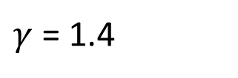

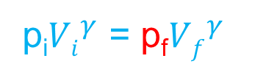
55. A certain gas occupies a volume of 4.3 L at a pressure of 1.2 atm and a temperature of 310 K. It is compressed adiabatically to a volume of 0.76 L. Determine (a) the final pressure and (b) the final temperature, assuming the gas to be an ideal gas for which γ = 1.4.
Solution:
Here, V_{i} = 4.3 L
p_{i} = 1.2 atm = 1.2x10⁵ Pa
T_{i} = 310 K
V_{f} = 0.76 L
$γ$ = 1.4
(a) p$V^{γ}$ = constant
p_{i}${Vi}^{γ}$ = p_{f}${Vf}^{γ}$
$\text{p}\text{f}=\frac{\text{p}\text{i}{Vi}^{γ}}{{Vf}^{γ}}$ =p_{i}( $\frac{{Vi}^{γ}}{{Vf}^{γ}}$) = ${p_{i}(\frac{V_{i}}{V_{f}})}^{γ}$ = ${\text{1.2}\text{x}{10}^{5}(\frac{\text{4.3 }\text{L}}{\text{0.76 }\text{L}})}^{1.4}$ $=\text{1.2}\text{x}{10}^{5}\text{(11.3166)}$= $\text{1.}\text{36}\text{x}{10}^{6} \text{Pa}$

Slide 9


(b) T$V^{γ−1}$ = constant
T_{i}${Vi}^{γ−1}$ = T_{f}${Vf}^{γ−1}$
T_{f} = $\frac{\text{T}\text{i}{Vi}^{γ−1} }{{Vf}^{γ−1}}$ = ${T_{i}(\frac{V_{i}}{V_{f}})}^{γ−1}$ = ${\text{310}(\frac{\text{4.3 }\text{L}}{\text{0.76 }\text{L}})}^{1.4−1}$ = 310(2.00) = 620 K

Slide 10
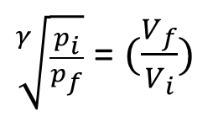

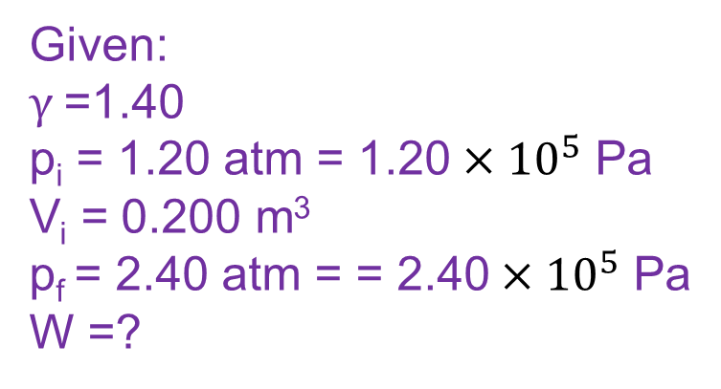
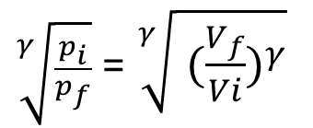
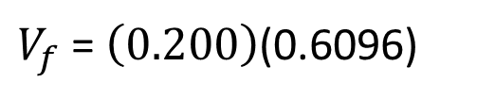
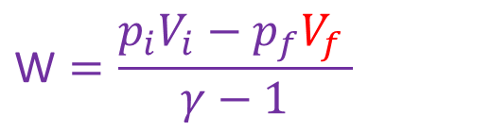
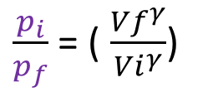
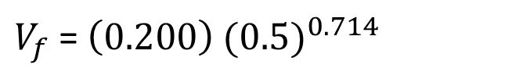
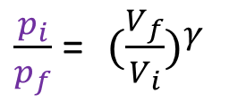
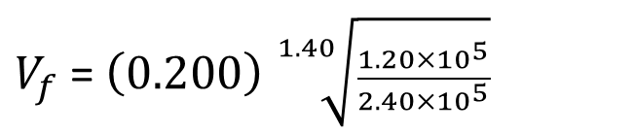
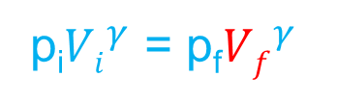
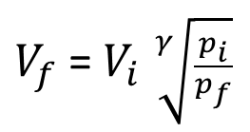
62. An ideal diatomic gas, with rotation but no oscillation, undergoes an adiabatic compression. Its initial pressure and volume are1.20 atm and 0.200 m³ . Its final pressure is 2.40 atm. How much work is done by the gas?
Solution:
p_{i}${Vi}^{γ}$ = p_{f}${Vf}^{γ}$
$V_{f}$= $V_{i}$ $\sqrt[γ]{\frac{p_{i}}{p_{f}}}$
Given:
$γ$=1.40
p_{i} = 1.20 atm = 1.20 $×{10}^{5}$ Pa
V_{i} = 0.200 m³
p_{f} = 2.40 atm = = 2.40 $×{10}^{5}$ Pa
W =?
$\frac{p_{i}}{p_{f}}$ = ( $\frac{{Vf}^{γ}}{{Vi}^{γ}}$)
$V_{f}$= $\left(0.200\right) \sqrt[1.40]{\frac{1.20×{10}^{5}}{2.40×{10}^{5}}}$
$\frac{p_{i}}{p_{f}}$ = ${ (\frac{V_{f}}{V_{i}})}^{γ}$
$V_{f}$= $\left(0.200\right)$ ${(0.5)}^{0.714}$
$\sqrt[γ]{\frac{p_{i}}{p_{f}}}$ = $\sqrt[γ]{{ (\frac{V_{f}}{Vi})}^{γ}}$
$$\text{W}=\frac{p_{i}V_{i}−p_{f}V_{f }}{γ−1}$$
$V_{f}$= $\left(0.200\right)$(0.6096)
$\sqrt[γ]{\frac{p_{i}}{p_{f}}}$ = $(\frac{V_{f}}{V_{i}})$
$$V_{f}=0.122 m3$$
V_{f} = ?

Slide 11
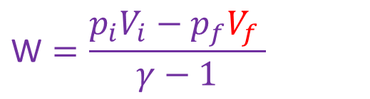
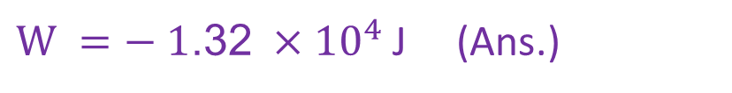
$$\text{W}=\frac{p_{i}V_{i}−p_{f}V_{f }}{γ−1}$$
$$\text{W} =\frac{\text{(}\text{1}\text{.}\text{2}\text{0} ×{10}^{5})(0.200)−\text{(}\text{2}\text{.}\text{4}\text{0} ×{10}^{5})(0.122)}{1.40−1}$$
$\text{W} =−$ $\text{1}\text{.}\text{3}\text{2} ×{10}^{4}$ J (Ans.)

